Slide 1
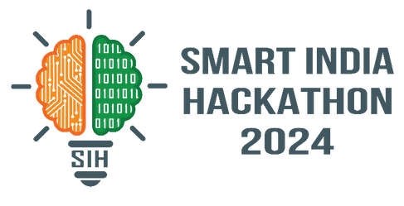

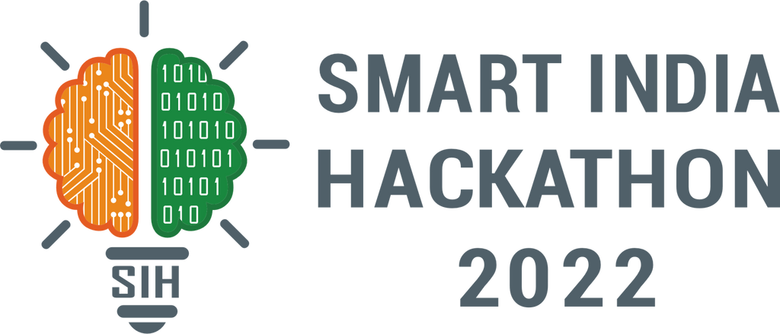
SMART INDIA HACKATHON 2024
Problem Statement ID – 1696
Problem Statement Title – A Software Application - Ground Water Level Predictor
Theme – Smart Automation
PS Category – Software
Team ID – AIML 08
Team Name – Water Benders
Team Members :
Suryaprakash S - 22AM062 Kishore Balaji B - 22AM031
Sanjai M - 22AM053 Saarathy Mithran R S - 22AM051
Manibharathi R - 22AM034 Kavya Shree V - 22AM030

Slide 2














GROUND WATER LEVEL PREDICTOR
WATER
WATER
BENDERS
BENDERS
PROPOSED SOLUTION
A DL model for predicting the Ground Water Level and building Web and Mobile Applications using that model.
Our Solution
The Model prevents the over extraction of ground water. Improves the productivity of crops as farmers make decisions based on ground water level and will avoid ineffective policies for water conservation.
Problem Solving
We use both historical and real-time data for more accurate predictions. The model can be adjusted to work in different regions by using local data.
Innovation & Uniqueness

Slide 3
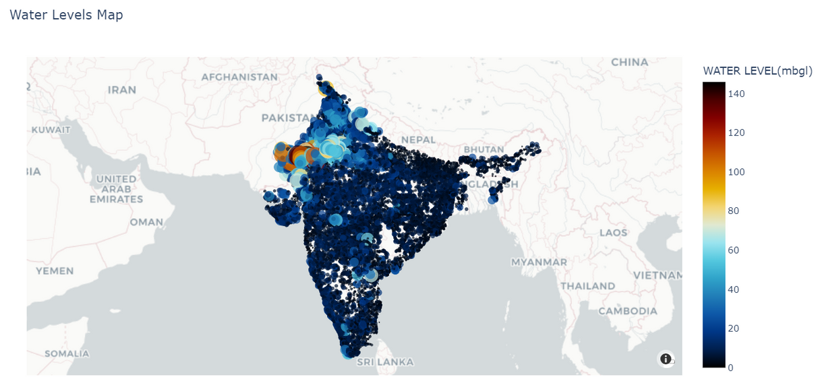
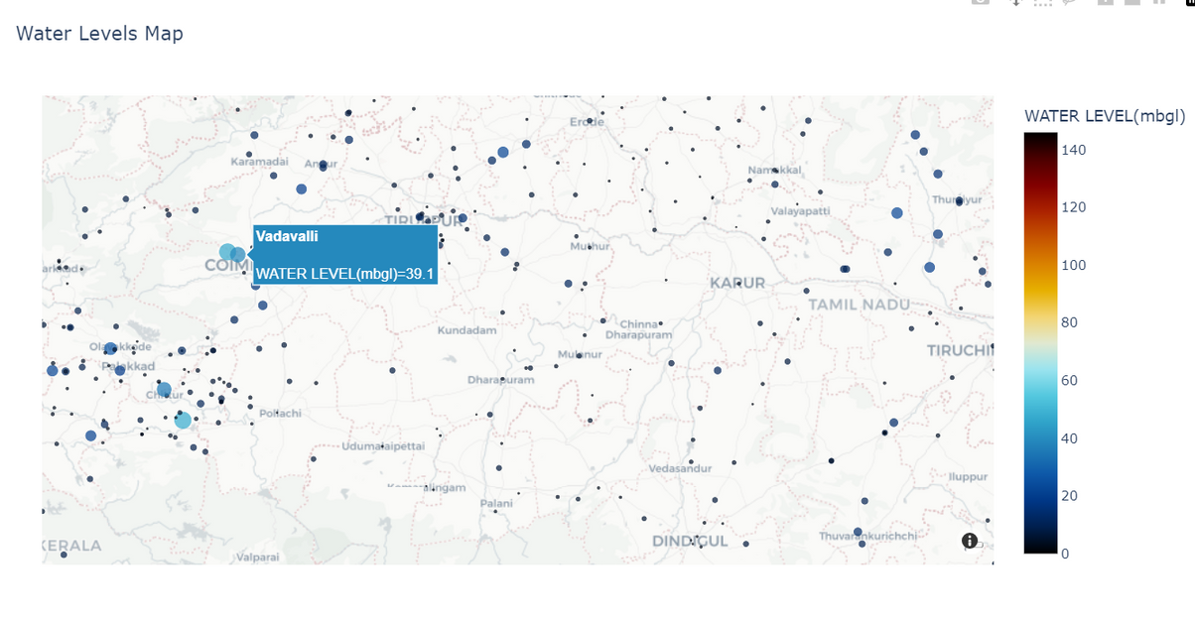
GROUND WATER DATA IN INDIA
WATER
BENDERS
PLOTLY VISUALIZATION GROUNDWATER LEVEL MAP OF INDIA
Points represent water levels at various locations.
Color scale: blue (shallow) to red/orange (deep).
Interactive map allows zoom and hover.
Highlights critical depletion in northern India.
Data Source : Central Ground Water Board (CGWB)Ministry of Jal Shakti,
Department of Water Resources,
River Development and Ganga Rejuvenation
Government of India
Notes:
6

Slide 4



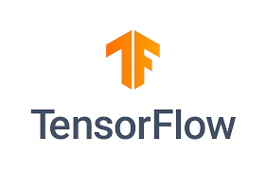


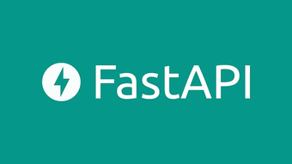



FLOW CHART & TECHNICAL STACK
WATER
BENDERS
Data Acquisation
Tensorflow Dataset
TECH STACK
Preprocessing (Image Resizing, Augmentation, etc.)
LSTM Model
Model Deployment
FastAPI Backend (TF Serving)
GCP Functions (TFLite Model)
Web App (React.js)
Mobile App (React NatIve)
Notes:
3

Slide 5

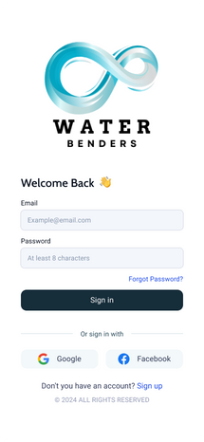
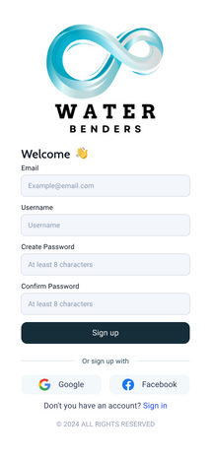
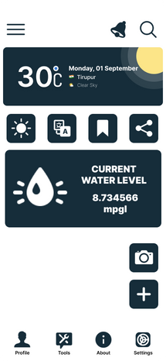
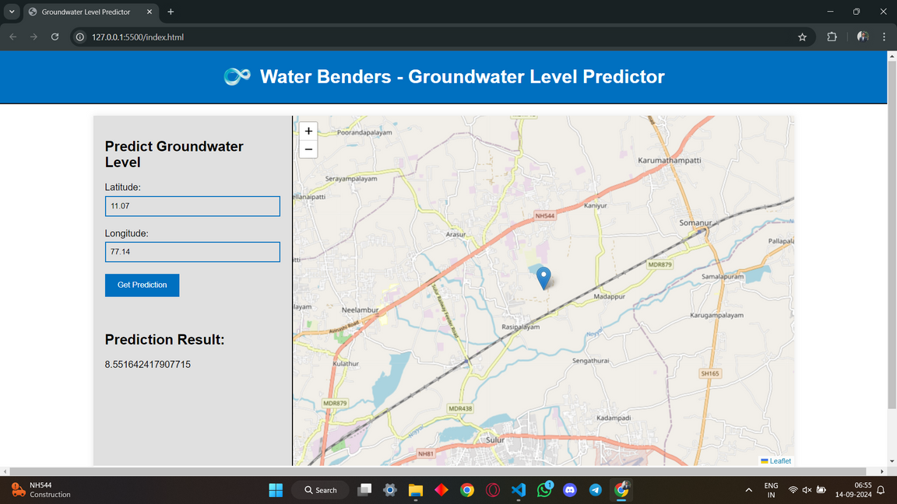
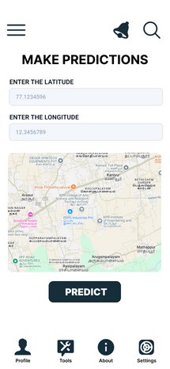
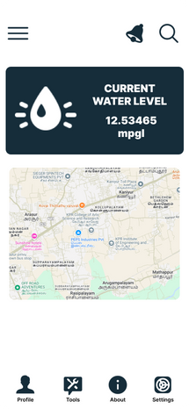
PROTOTYPE
WATER
BENDERS
b) Web Application
a) Mobile Application

Slide 6





FEASIBILITY
VIABILITY
WATER
BENDERS
Easy to Access:
Available on both web and app, so users can check water levels anytime, anywhere.
Helps Plan Daily Activities:
Helps users manage water usage for farming or household needs.
Useful for Everyone:
Works for different users like farmers, homeowners, and city planners.
Promotes Water Conservation:
Encourages smart water usage to prevent running out, helping the environment too.
Low Cost:
Saves money by providing predictions without expensive surveys.
Instant Alerts:
Sends notifications about changes in water levels for timely decisions.
Simple Design:
Easy to use for everyone, navigate seamless and no technical skills needed.
Localized Data:
Gives predictions relevant to specific regions or needs.
Real-Time Info:
You get quick, up-to-date information to take action when needed.
Better Decisions:
Provides reliable data to help in planning and resource management.

Slide 7



IMPACTS AND BENEFITS
WATER
BENDERS
01.SUSTAINABLE WATER MANAGEMENT:
01.ACCURATE AND RELIABLE FORECASTING:
Improves long-term water resource planning, helping ensure the conservation of water supplies and protection of ecosystems by preventing over-extraction.
Provides precise groundwater predictions, enabling smarter decisions for both agricultural and urban needs. This helps optimize water usage, ensuring resources are allocated effectively.
02.AGRICULTURAL AND URBAN PLANNING:
02.USER-FRIENDLY DECISION-MAKING TOOLS:
01
01
Provides accurate groundwater data for better crop management and helps urban planners develop sustainable cities based on water availability.
Simplifies complex water data into easy-to-use formats, significantly improving decision-making for farmers, city planners, and government officials.
02
02
IMPACTS
BENEFITS
AND
03.DISASTER PREVENTION AND RISK MANAGEMENT:
03.COST AND ENERGY EFFICIENCY:
Identifies areas at risk for droughts or water-related disasters, enabling early action to mitigate potential damage and shortages. This proactive approach helps communities prepare and protect vital resources.
03
03
Reduces exploration and extraction costs by offering precise groundwater data, leading to better resource allocation, lower energy usage, and increased operational efficiency for sustainable practices.
04
04
04.INFORMED POLICY AND ENVIRONMENTAL PROTECTION:
04. REAL-TIME MONITORING AND RESOURCE OPTIMIZATION:
Supplies policymakers with valuable data to create effective water-use regulations while supporting environmental conservation efforts.
Enables continuous tracking of water levels, ensuring efficient water use, reducing waste, and promoting sustainable practices across sectors.
RESEARCH & REFERENCES
https://youtu.be/RYU3O9w456I?si=YRxwlxEgvrOr6YX-
https://www.frontiersin.org/journals/environmental-science/articles/10.3389/fenvs.2024.1291327/full
https://www.sciencedirect.com/science/article/pii/S092523122200282X
Karpatne, A., Atluri, G., Faghmous, J. H., Steinbach, M., Banerjee, A., Ganguly, A., ... & A, V. Theory-guided data science: A new paradigm for scientific discovery from data. IEEE Transactions on Knowledge and Data Engineering
Shalev-Shwartz, S., & Ben-David, S. (2014). Understanding machine learning: From theory to algorithms. Cambridge University Press.

